Slide 1


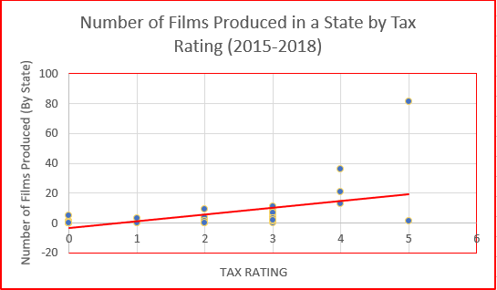
The Impact of Film Production Tax Incentives
on Location Representation in Film
By Matthew Borelli, Department of Economics, mjb15j@my.fsu.edu
. Presented at the Association of Private Enterprise Education, April 6, 2019
Do tax incentives for film production affect production and setting location choice?
Table/Chart primary results here
Conclusions
Stephanie Leiser (2017) reported that an interviewee of hers stated that in terms of tax incentive programs for film, “if you’re not the best state—then you might as well not be in the business” (258-259). This research has shown that states receive mixed benefits from having the best tax benefit programs. While these states receive more film productions, in return their states receive much less representation in film narratives than one would expect. In this sense, tax incentive programs for film production are not currently efficient for states and different regulations should be considered for the future of these programs.
Project Summary
The main goal of this research is to examine the relationship between ratings for state film production tax incentive programs and the number of films produced in a state as well as the amount of times films produced in a state had narratives set in the same state (labeled as location representation). This analysis looked at approximately 700 films released in the U.S. between 2015 and 2018. Films were classified by their production state, setting state, labor force statistics of the production state (both film and general private industry), and star rating of their tax incentive program from Film Production Capital. Films produced in foreign countries and animated films were culled out of the original 700 data points, leaving 300 films for analysis. Lastly, many analyses in this project remove films from New York and California because they are outliers due to proximity to the film industry.
Empirical Results
The first step was running logistic regression on the probability of a film featuring location representation against the tax rating of the production state (p > 0.0027). The coefficient for the tax rating was negative, meaning that higher interest rates on tax credits and rebates makes it less likely for a film to feature location representation. This is supported by looking at the distribution of films with unspecified settings, where the location of the film is not mentioned within the film. 67.4% of films with unspecified locations were produced in states with a 4 or 5 star rating, which account for 12% of the states (not including California or New York). Lastly, the graph above shows that as the tax rating of an individual state increases, so does the number of films produced within that state.
References
"U.S. Tax Incentive Info." Film Production Capital. Accessed October 25, 2018. http://www.filmproductioncapital.com/taxincentive.html
Leiser, Stephanie. "The Diffusion of State Film Incentives: A Mixed-Methods Case Study." Economic Development Quarterly 31, no. 3 (2017): 255-67. doi:10.1177/0891242417710715.

Slide 2
The Impact of Film Production Tax Incentives
on Location Representation in Film
By Matthew Borelli, Department of Economics, mjb15j@my.fsu.edu
Presented at the Association of Private Enterprise Education, April 6, 2019
Do tax incentives for film production affect production and setting-location choice?
Conclusions
States receive mixed benefits from having the most generous tax benefit programs (4 or 5 rating).
States with a 4 or 5 tax rating receive more film productions than those with a 3 or less rating.
States receive much less setting representation in film narratives than one would expect, especially Georgia and Louisiana.
Tax incentive programs for film production do not have a significant effect on setting location choice. In order to get more films set in a state, different programs should be considered.
Georgia = 81
Project Summary
Examined the relationship between ratings for state film production tax incentive programs and the number of films produced in a state.
Also examined the amount of times films produced in a state had narratives set in the same state (labeled as location representation).
Sample--approximately 700 films released in the U.S. between 2015 and 2018.
Films were classified by: production state, setting state, labor force statistics of the production state (both film and general private industry), and star rating of their tax incentive program from Film Production Capital (on a scale of 1 to 5).
Georgia = 12
Figure 1
Figure 2
Empirical Results
The coefficient for the tax rating using logistic multiple linear regression was negative- larger percentages on tax credits and rebates given to film studios makes it less likely for a specific film to feature location representation.
This is supported by looking at the distribution of films with unspecified settings, where the location of the film is not mentioned within the film. 67.4% of films with unspecified locations were produced in states with a 4 or 5 star rating, which account for 12% of the states (not including California or New York).
As the tax rating of an individual state increases, so does the number of films produced (Figure 1) and set (Figure 2) within that state, with a stronger effect on the production location.
Anecdotally, two states have a large gap between the amount of films produced and set in the state: Georgia, with 81 films produced in the state compared to 12 set in it, and Louisiana with 36 and 6, respectively.
References
"U.S. Tax Incentive Info." Film Production Capital. Accessed October 25, 2018. http://www.filmproductioncapital.com/taxincentive.html
Thom, Michael. "Lights, Camera, but No Action? Tax and Economic Development Lessons From State Motion Picture Incentive Programs." The American Review of Public Administration 48, no. 1 (2016): 33-51. doi:10.1177/0275074016651958.

